Slide 1
Wednesday, February 20, 2013
Agenda:
No TISK or MM
Review HW
Lesson 13-6 Part 1: Multiplying Binomials
HW: Start 13-6 problems

Slide 2

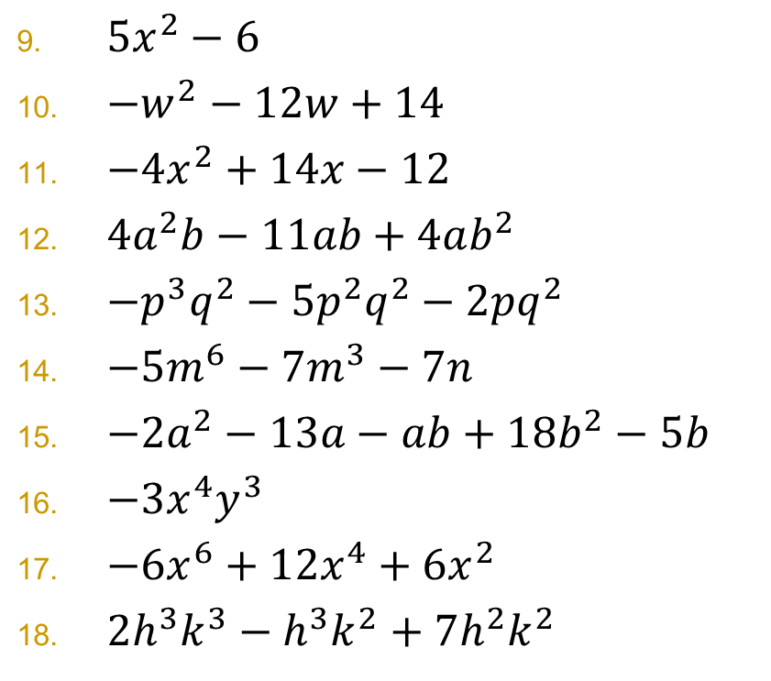
Homework Check
$5x^{2}−6$
$−w^{2}−12w+14$
$−4x^{2}+14x−12$
$4a^{2}b−11ab+4ab^{2}$
$−p^{3}q^{2}−5p^{2}q^{2}−2pq^{2}$
$−5m^{6}−7m^{3}−7n$
$−2a^{2}−13a−ab+18b^{2}−5b$
$−3x^{4}y^{3}$
$−6x^{6}+12x^{4}+6x^{2}$
$2h^{3}k^{3}−h^{3}k^{2}+7h^{2}k^{2}$
$24m^{4}n^{2}−40m^{3}n^{3}+16m^{3}n$
$−112t^{2}+140t−105$
$−3x^{11}+2x^{10}−5x^{2}−5$
Check the order of your terms on these problems for full credit.

Slide 3
§13-6 Multiplying Binomials
You’re still distributing!

Slide 4

A “quick” way to remember it.
FOIL
  First
  Outer
  Inner
  Last

Slide 5
Once more, together
Multiply: $(3−n)(4−n)$

Slide 6
Your Turn

Slide 7
Your Turn

Slide 8
Your Turn

